Slide 1
HOW JAVA WORKS ?

Slide 2

.java File
Compile
(ByteCode) class File

Slide 3
java program execute JVM

Slide 4
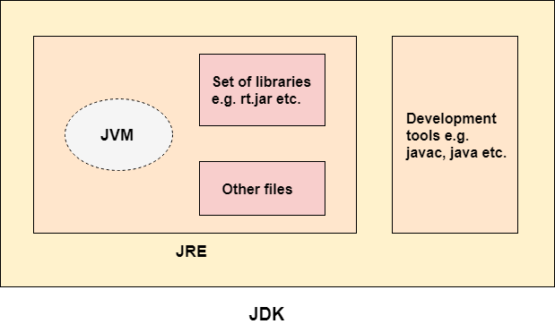

Slide 5
Step 1 : classloader - load class for JVM execution
Step 2 : bytecode verifier - verifies the bytecod
Step 3 : Interpreter - It read the bytecode instructions and execute them line by line.
Step 4 :Show on Hardware

Slide 6
JVM :
provides a secure runtime environment to execute the bytecode generated through the compiler
JVM actually invokes the main( ) method present in the Java program.
JVM is a part of the JRE(Java Runtime Environment).

Slide 7
JRE :
Java Runtime Environment provides the minimum requirements for executing a Java application
JRE consists of the Java Virtual Machine (JVM), core classes, and supporting files.

Slide 8
Java Development Kit (JDK) :
Java Development Kit (in short JDK) is a Kit that provides the environment to develop and execute.
The JDK contains a private Java Virtual Machine (JVM), interpreter/loader (java), a compiler (javac), an archiver (jar), a documentation generator (Javadoc), etc. to complete the development of a Java Application.

